Slide 1
Beginner’s Learning Blazor Part 1 – About Blazor Components
Kaushik Roy Chowdhury

Slide 2
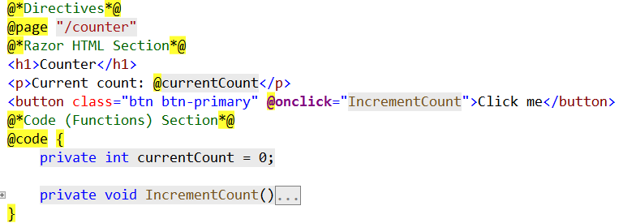
Blazor Components
The basic structure of a component in blazor can be classified into three sections as below:

Slide 3
The description of these three sections follow:
Directives section:
The directive section in a Blazor component is used to
Configure routing for current component
Imports any external class library
Injecting dependency
Razor HTML section:
Razor syntax is a combination of HML and C# code
This section renders on the browser
Code(Functions) section:
The code section in a component holds user action functions like event, methods, local variables and properties to be passed back and forth between parent and child components

Slide 4
Beginner’s Learning Blazor Part 2 – Data Binding (One Way Binding)
Kaushik Roy Chowdhury

Slide 5
Outcomes of this lecture:
In this lecture, we shall discuss the concept of one way binding in Blazor
Build a one way razor component in Blazor that increments a counter on a button click and toggles between two messages with different styles on a paragraph

Slide 6
In One Way Binding
Updates to the value that a control has is unidirectional, or flows one way
To render a label with updated text dynamically is an example of one way binding
In Blazor, one way binding could be in response to the triggering of an event by the user, such as a button click
One way binding will modify the value of the label above as the user will not be able to do so directly
Event Triggered by User
Value gets Updated
Updated Value is Rendered(Shown)

Slide 7
Beginner’s Learning Blazor Part 2 – Data Binding (Two Way Binding)
Kaushik Roy Chowdhury

Slide 8
Outcomes of this lecture:
In this lecture, we shall discuss the concept of two way binding in Blazor
Create a Blazor component which collects form based user data and demonstrates two way data binding(by rendering user updated data on the browser immediately)

Slide 9
In Two Way Binding
It has a two direction flow, allowing values to be updated from two directions
As the user types in the data into an form input control, the data updates and renders on the browser
Two way binding can be used anywhere that an application needs a user input, primary use still being in forms
The main way that two way binding is used in Blazor is through the use of bind attribute

Slide 10
Bind Attribute Forms:
The bind attribute is a very flexible and versatile method for binding in Blazor
It has three different forms
The various forms allow developers to be specific about how to implement the binding
@bind = Property
@bind-value = Property
@bind-value = Property @bind-value:event = “onevent”

Slide 11
Conclusions:
We discussed the concept of basic two way binding in Blazor
Created a Blazor component which collects form based user data and demonstrates two way data binding(by rendering user updated data on the browser immediately)

Slide 12
Beginner’s Learning Blazor Part 3 – (Blazor Components)
Kaushik Roy Chowdhury

Slide 13
Rules Guiding Component Classes
A component which is formed of C# and HTML is referred to as a Razor Component
The first letter of a component’s name must start with an uppercase character. Hence Dialog is valid whereas dialog is not
The component class members which are defined in @code block contain properties, fields and methods for event handling
More than one @code block is permitted
Although @functions block which was used for the same purpose as @code in earlier preview versions of ASP.NET Core 3.0 still works, Microsoft recommends using @code block

Slide 14
Rules Guiding Component Classes (Contd):
Using C# expression that start with an @, component members can be used as part of rendering logic
The Visual Studio code example evaluates and renders:
_headingColor to the CSS property value for color.
_headingMessage to the content of the <h2> element.

Slide 15
Beginner’s Learning Blazor Part 4 – (Event Handling)
Kaushik Roy Chowdhury

Slide 16
Event Handling
Components in Blazor provide event handling features
An HTML element attribute, say onclick or onchange (in general on{event}) with a delegate-typed value is treated as an event handler(method) by razor components.
The code shown next in Visual Studio 2019 calls the ChangeHeading method when the button is selected. So here ChangeHeading is an event handler(method).
These event handlers can also run asynchronously and return a Task when the button is selected

Slide 17
Event argument types
A few events have event argument types permitted
e.g. Keyboard event has KeyboardEventArgs and Mouse event has MouseEventArgs
The method calls only require these event types if access to one of these event types is necessary

Slide 18
Conclusion
We saw how Event handling is done in Blazor and saw that an HTML attribute with a delegate-typed value is a method that runs on the trigger of an event: onclick of a button
Some events have event arguments which are used in certain cases like in the example to find the X-Y mouse coordinates at the point of click

Slide 19
Beginner’s Learning Blazor Part 4 – (EventCallback)
Kaushik Roy Chowdhury

Slide 20
EventCallback
A common scenario when there are nested components is that the parent component’s method should run when a child component’s event gets triggered
An EventCallback is used to expose events across components
In this case, a parent component can assign a callback method to a child’s EventCallback

Slide 21
Conclusion
Event Callbacks were seen and how they help in exposing events across components

Slide 22
Checkbox event handling in Blazor framework
Kaushik Roy Chowdhury

Slide 23
How do we handle onchange event in a checkbox when the user checks or unchecks it?
This tutorial shows how to handle checkboxes when they are checked or unchecked in Blazor so that they represent their correct state.
We shall show it in code through Visual Studio 2019 project

Slide 24
What we did in code?
<input type="checkbox" class="form-check-input" @onchange="CheckChanged"/>
<p>@checkChanged</p>
@code
{
private string checkChanged = "I am not checked";
[Parameter] public bool isChecked { get; set; } = true;
private void CheckChanged()
{
if(isChecked)
{
checkChanged ="You have checked me now!!";
isChecked = !isChecked;
}
else
{
checkChanged = "Unchecked now!!";
isChecked = !isChecked;
}
}
}

Slide 25
Checkbox event handling in Blazor framework
Kaushik Roy Chowdhury

Slide 26
How do we handle onchange event in a checkbox when the user checks or unchecks it?
This tutorial shows how to handle checkboxes when they are checked or unchecked in Blazor so that they represent their correct state.
We shall show it in code through Visual Studio 2019 project

Slide 27
What we did in code?
<input type="checkbox" class="form-check-input" @onchange="CheckChanged"/>
<p>@checkChanged</p>
@code
{
private string checkChanged = "I am not checked";
[Parameter] public bool isChecked { get; set; } = true;
private void CheckChanged()
{
if(isChecked)
{
checkChanged ="You have checked me now!!";
isChecked = !isChecked;
}
else
{
checkChanged = "Unchecked now!!";
isChecked = !isChecked;
}
}
}

Slide 28
Beginner’s Learning Blazor Part 5 – (Chained bind)
Kaushik Roy Chowdhury

Slide 29
Chained bind
In a chained bind, multiple levels of binding occur at the same time and that’s why the name “chained bind”
In chained bind, the event handler and the value must be specified separately i.e. @bind syntax can’t be used to implement chained bind in the page’s element.
A parent component however can use the @bind syntax with the child component’s parameter

Slide 30
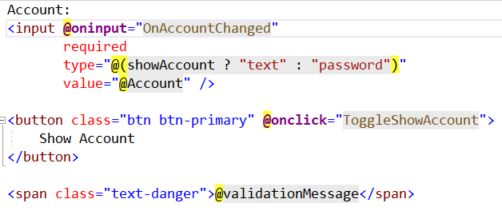
Chained bind
In the Visual Studio project, we have seen a AccountField component that sets the account number field in a text input and traps errors if a space has been used in the account number value
AccountField.Razor (Fig1)

Slide 31
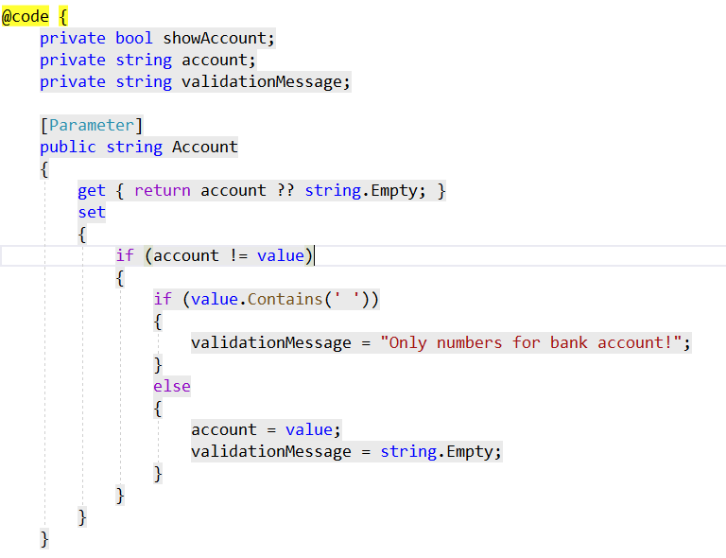
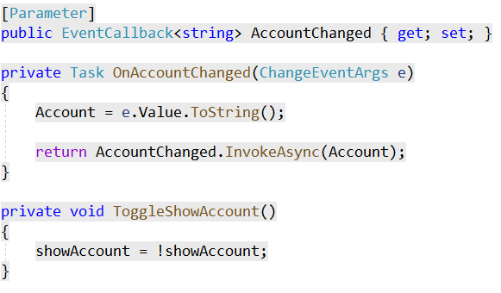
Chained bind
AccountField.razor (Child Component) Fig 2
Fig 3

Slide 32
Chained bind
AccountSetter.razor (Parent Component)
@page "/AccountSet"
<AccountField @bind-Account="account" />
@code {
private string account;
}

Slide 33
Conclusion
Chained bind helps implementing multiple levels of binding simultaneously

Slide 34
Beginner’s Learning Blazor Part 6 – (Component Base Class Specification)
Kaushik Roy Chowdhury

Slide 35
Component Base class needs to be specified
When a Blazor component is created it should inherit from ComponentBase class.
The first reason is that it implements IComponent interface which Blazor uses to locate components throughout the project
Secondly, ComponentBase contains important lifecycle methods which will be taken in another tutorial
In this tutorial, we shall see how a component can inherit a base class, CoolBlazorBase to provide its properties and methods

Slide 36
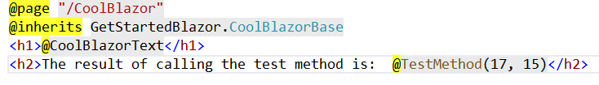
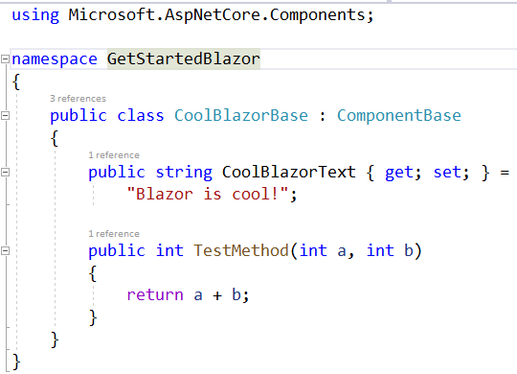
Component Base class needs to be specified
Code: (CoolBlazor.razor)
CoolBlazorBase.cs

Slide 37
Beginner’s Learning Blazor Part 7 – (Lifecycle methods for components)
Kaushik Roy Chowdhury

Slide 38
Component lifecycle methods
During their lifecycle, Blazor components undergo the following synchronous as well as asynchronous lifecycle methods
OnInitialized()/OnInitializedAsync()
OnParametersSet()/OnParametersSetAsync()
OnAfterRender/OnAfterRenderAsync

Slide 39
Beginner’s Learning Blazor Part 8 – (Routing)
Kaushik Roy Chowdhury

Slide 40
Routing in Blazor
In Blazor, the route template provided to the accessible components makes the routing possible
A component (which is a Razor file) with @page directive, when compiled, generates a class
This generated class is given a RouteAttribute which specifies the route template
At runtime, the router looks for matching route templates with the requested URL in component classes with RouteAttribute
The router then renders that component which matches as above
Class1
Classes with route templates
Razor file1 with @Page
Compile time
Runtime
Class2
Class(RouteAttribute)
Razor file2 with @Page
Class3
Razor file 3 rendered (assumes it has a template that matched incoming URL
Razor file3 with @Page
Router
URL: https://localhost:port/Counter

Slide 41
Multiple Route Templates
We can apply more than one route templates to a component
@page "/Dialog"
@page "/SampleDialog"
<h1>Dialog Component</h1>

Slide 42
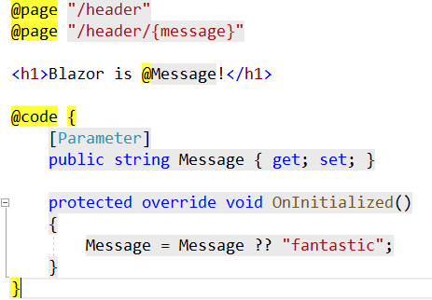
Route parameters
The route templates provided in the @page directive can pass route parameters to the components
Corresponding component parameters are populated by the route parameters by the router

Slide 43
Beginner’s Learning Blazor Part 9 – (Templated Components)
Kaushik Roy Chowdhury

Slide 44
Templated components
Templated components are components that accept one or more UI templates as parameters
This is then used as part of the rendering logic
This allows user to author higher level components that are highly reusable
One of the examples that I am going to cover in this tutorial is a list component that allows a user to specify a template for items in a list for rendering

Slide 45
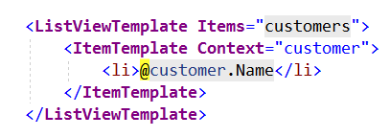
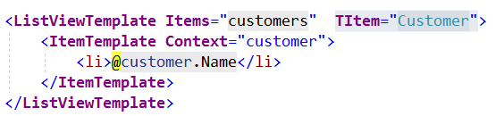
Generic typed components
Templated components are generically typed often. (I shall demonstrate this in code)
Usage of @typeparam directive is made for defining a generic component
When using generic-typed components, the type parameter is inferred if possible
Otherwise, the type parameter is explicitly specified (using attribute that matches the name of the type parameter)

Slide 46
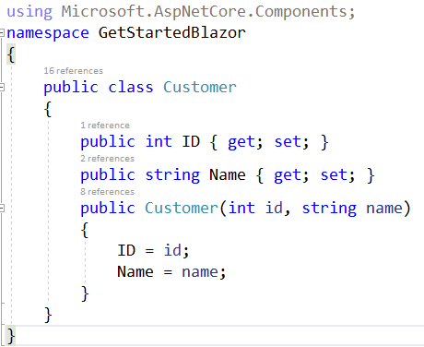
Generic typed components
Customer.cs

Slide 47
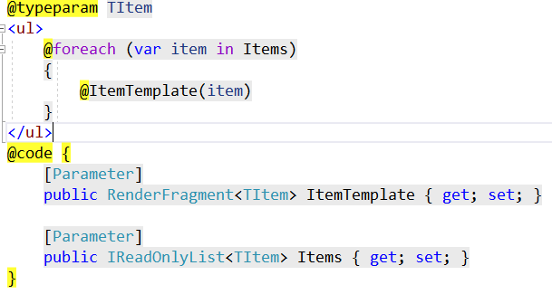
Generic typed components
ListViewTemplate.razor

Slide 48
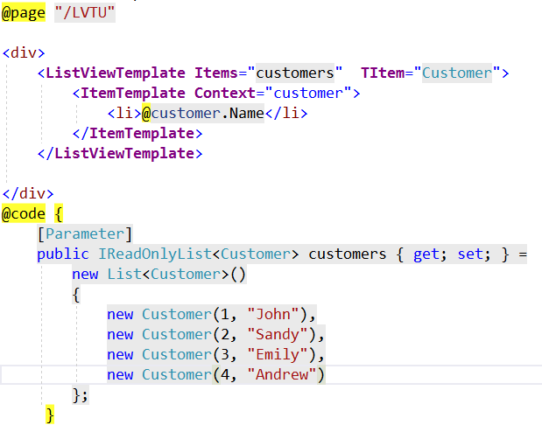
Generic typed components
ListViewTemplateUser.razor

